Slide 1

A PROJECT FOR DBAS 3021 METADATA MANAGEMENT
JAMIE LU | W0441213 | DECEMBER 2020

Slide 2
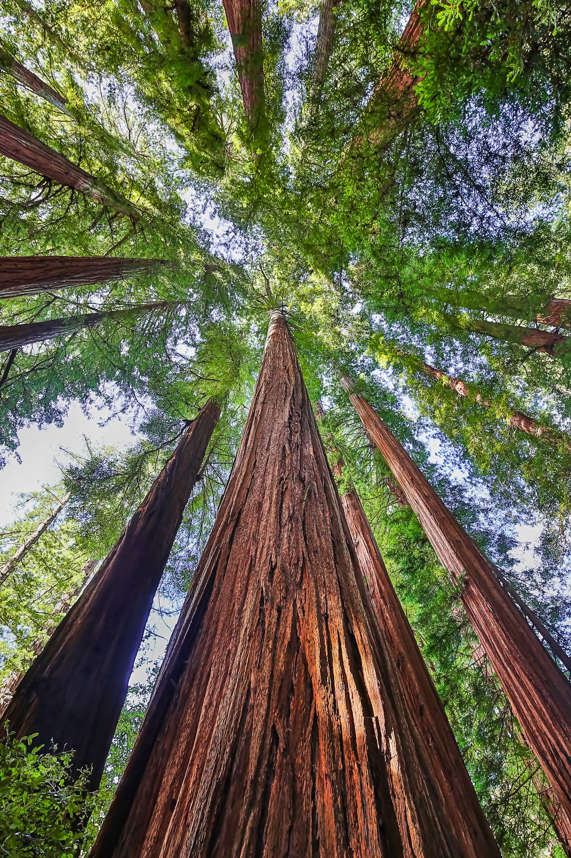
JOURNEY
THE
OF A
VIDEO FILE

Slide 3

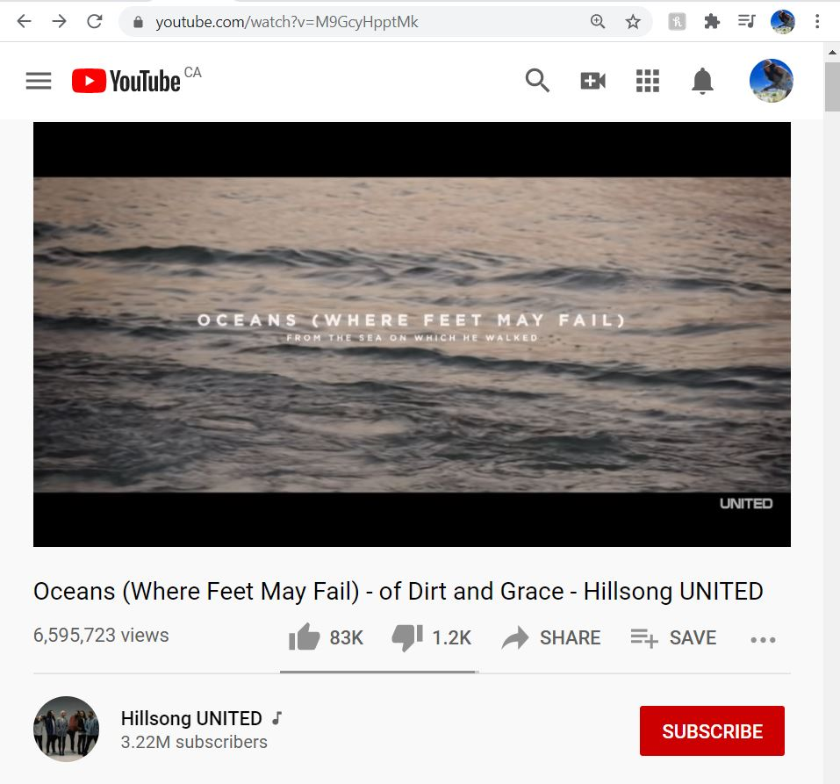

Slide 4

GLOSSARY
BUSINESS
TERMINOLOGY | DEFINITION
A.S.C.A.P “The American Society of Composers, Authors, and Publishers” | An American performing rights organization Responsible for copyright protection of its members and their performances
Album | - A collected of selected music by an artist/s.
Artist | An individual or group of individuals that creates, performs, and releases music Can be with or without a record label
BPM “beats per minute” | How the tempo of a song is measured
Business Manager | An individual or company that manages an artist’s performances, income, expenses, and investments Charges a percentage of the artist’s income
Composer | The person responsible for creating the music to a song
Copyright | The exclusive rights that is granted to the owners of a song Whoever has it has control over the use of the song
Copyright Infringement | Unauthorized use of a copyrighted song
Creator | Individual/s that produce content for YouTube
License | A legal permit Permission to use or perform a song by another artist

Slide 5
GLOSSARY
BUSINESS
TERMINOLOGY | DEFINITION
Licensee | - The owner of the licensed music
Licensor | The group or individual to whom the music is licensed
Lyrics | The words to a song
Marketing | The process of increasing public interest in an artist’s work using promotions and exposure in media to increase sales
Music Video | A visual/video presentation of the song It usually is related to the lyrics or theme of the song
Public Domain | A music or work that is free from copyright protection It is available to be used by anyone with no restriction
Subscriber | An individual that has elected to follow a channel to stay updated on the content that channel has
Verse | The portion of the song before the chorus and after the intro
Views | When a user opens a video intentionally and it has to be for at least 30 seconds
Work | - Any visual, musical, literary, or dramatic product which can be copyrighted

Slide 6


DESCRIPTIVE METADATA
CONCLUSION
07
SOURCE TO TARGET MAPPING
06
DATA LINEAGE
05
ADMINISTRATIVE METADATA
02
PRESERVATION METADATA
03
01
STRUCTURAL METADATA
04

Slide 7
VIDEO TITLE: Oceans (Where Feet May Fail) - of Dirt and Grace - Hillsong UNITED DESCRIPTION: A music video of the song Ocean’s (Where Feet May Fail) by Hillsong United set at the Sea of Galilee in sunrise. GENRE: Christian Worship RELEASE DATE: 23 AUG 2013 CREATOR: Hillsong UNITED URL: https://youtu.be/M9GcyHpptMk VIEWS: 6,595,723 (as of 12-07-2020, 12:50AM) LIKES: 83K (as of 12-07-2020, 12:50AM) DISLIKES: 1.2K (as of 12-07-2020, 12:50AM) VIDEO LENGTH: 08:17 PRODUCER: Michael Chislett RECORD LABEL: Hillsong, Capitol CMG SONG TITLE: Ocean’s (Where Feet May Fail) ARTIST: Hillsong United SONG WRITER: Matt Crocker, Joel Houston, Salomon Ligthelm ALBUM: Of Dirt and Grace
DESCRIPTIVE METADATA

Slide 8
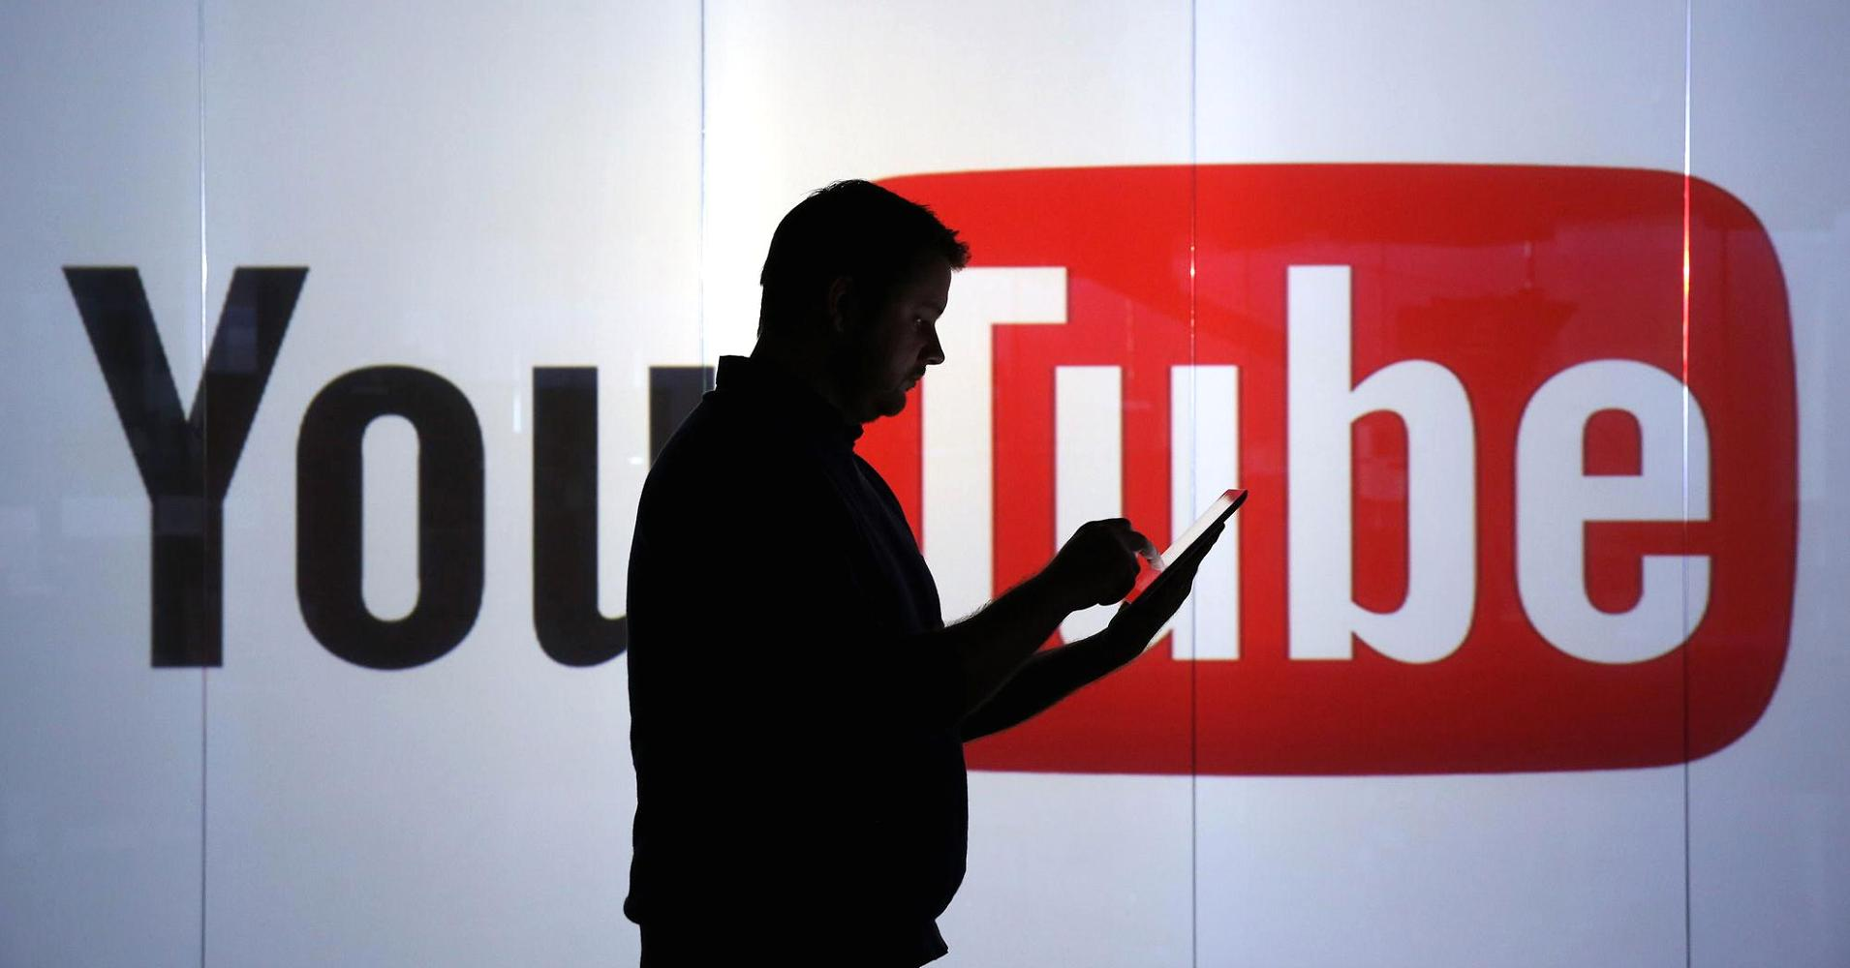

TECHNICAL METADATA DIGITAL PROVENANCE METADATA RIGHTS METADATA
ADMINISTRATIVE METADATA
This Photo by Unknown Author is licensed under CC BY

Slide 9



TECHNICAL METADATA
<iframe width="552" height="311" src="https://www.youtube.com/embed/M9GcyHpptMk" frameborder="0" allow="accelerometer; autoplay; clipboard-write; encrypted-media; gyroscope; picture-in-picture" allowfullscreen></iframe>
M9GcyHpptMk / 34HP XSB5 VVM1
552x311*1.56
EMBED
Video ID / sPCN
Viewport / Frames

Slide 10
TECHNICAL METADATA
854*480@24 / 854x480@24
av01.0.04M.08 (397) / opus (251)
bt709 / bt709
Current / Optimal Res
Codecs
Color

Slide 11
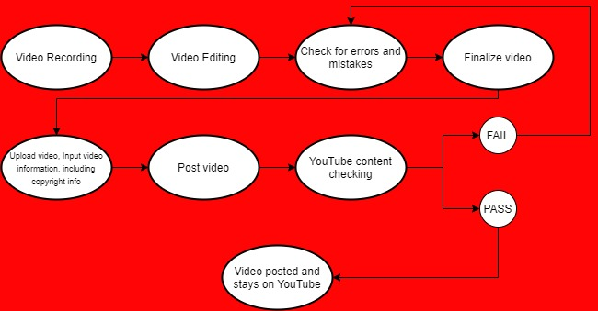


DIGITAL PROVENANCE
Notes:
STICKERS (YOUTUBE, YOUTUBE BUTTON): This Photo by Unknown Author is licensed under CC BY-SA

Slide 12

COPYRIGHT: © 2012 Hillsong Music Publishing LICENSEE: YOUTUBE LICENSOR: Hillsong (on behalf of Hillsong Music and Resources LLC); Canzion Group (Publishing), Adorando Publishing, ASCAP, CMRRA, Capitol CMG Publishing, UMPI, and 17 Music Rights Societies FAIR USE – use without need of permission Factors: 1) Purpose and character of use 2) Nature of copyrighted work 3) Amount and substantiality of the portion used in relation to the entirety of the copyrighted work 4) Effect of the use upon the potential market MORE INFORMATION ON YOUTUBE LICENSING
RIGHTS/ACCESS TO METADATA
This Photo by Unknown Author is licensed under CC BY-NC

Slide 13


ROYALTIES Every song has a mechanical (music and lyrics) and performance royalty. The mechanical royalty is given to the songwriter, while the performance royalty is given to the Hillsong church. Song performers’ profit for the performance of a song depends on the church, if they leave the church, they may stop getting paid even while it is still generating revenue. FREE USE Any church or place of worship has permission to play or perform a song by Hillsong United as an act of worship. More information at the source.
RIGHTS/ACCESS TO METADATA
This Photo by Unknown Author is licensed under CC BY-NC

Slide 14

PROVENANCE who has had custody of the data AUTHENTICITY: is the data what it appears to be? - YES. THE DATA APPEARS TO BE A MUSIC VIDEO FOR THE SONG, OCEANS (WHERE FEET MAY FAIL) BY HILLSONG UNITED, AND IT IS THAT. PRESERVATION ACTIVITY: Copyright terms have been established. TECHNICAL ENVIRONMENT: What is needed to render and use it? RIGHTS MANAGEMENT: check RIGHTS AND ACCESS TO METADATA SLIDES
PRESERVATION METADATA
This Photo by Unknown Author is licensed under CC BY

Slide 15
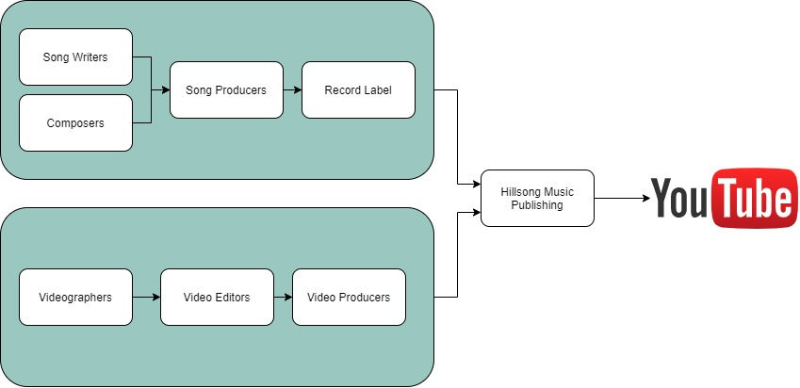
PROVENANCE
Notes:
STICKERS (YOUTUBE, YOUTUBE BUTTON): This Photo by Unknown Author is licensed under CC BY-SA

Slide 16
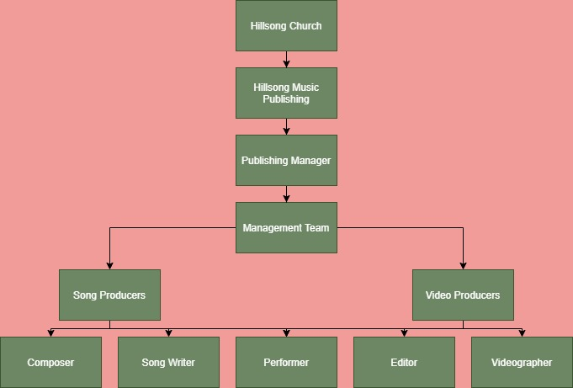
ORGANIZATIONAL CHART
Notes:
STICKERS (YOUTUBE, YOUTUBE BUTTON): This Photo by Unknown Author is licensed under CC BY-SA

Slide 17

Video and Audio Codecs (H.264, VP8, VP9, etc)
3D Rendering
Web page rendering
Video Rendering
.MOV
.MPEG4
.MP4
.AVI
.WMV
.MPEGPS
.FLV
3GPP
WebM
DNxHR
ProRes
CineForm
HEVC (h265)
Rendering and Codecs
Supported File Types

Slide 18

INTERNAL NAME: 23-08-2013-Oceans-Where_Feet_May_Fail_HSU SUMMARY SHORT: A music video of the song Ocean’s (Where Feet May Fail) by Hillsong United shot at the Sea of Galilee in sunrise TITLE BRIEF: Oceans (Where Feet May Fail) – Hillsong United TITLE SORT NAME: Hillsong United - Christian Worship RELEASE DATE: 23 AUG 2013 CREATOR: Hillsong UNITED PLAYLIST: Of Dirt and Grace (Live From The Land) (Official Playlist) VIDEO SEQUENCE: NO. 22 NUMBER OF CLIPS: 27
STRUCTURAL METADATA
This Photo by Unknown Author is licensed under CC BY-SA

Slide 19
METS
<dmdSec> descriptive metadata Section
<metsHdr> mets Header
<amdSec> administrative metadata section
<fileSec>file section
<structLink> structural Link section
<structMap> structural Map section
<behaviorSec> behavior section
ETADATA
NCODING &
RANSMISSION
TANDARD
This Photo by Unknown Author is licensed under CC BY-SA
STRUCTURAL METADATA
Notes:
http://www.loc.gov/standards/mets/METSPrimer.pdf

Slide 20
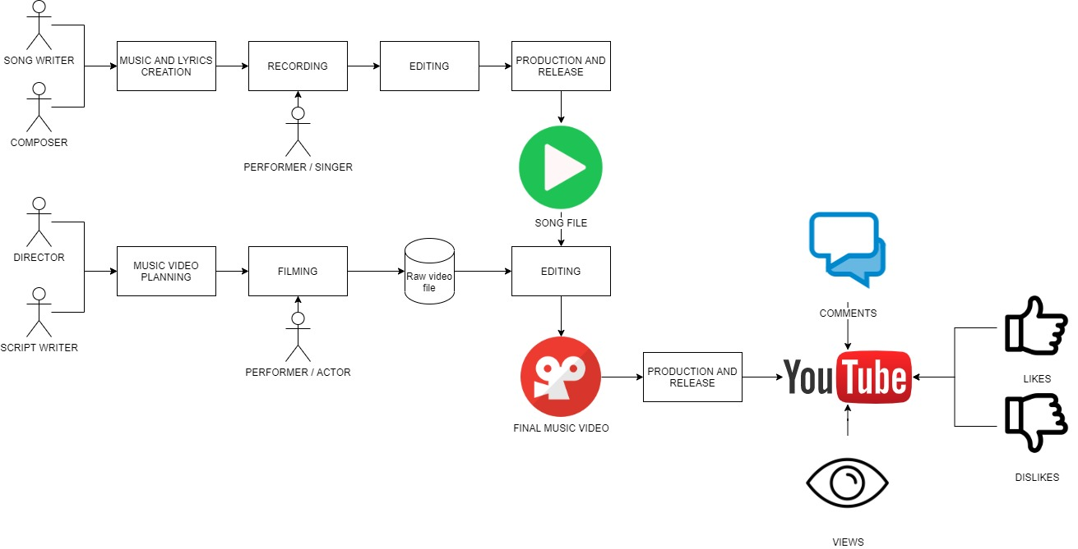
DATA LINEAGE

Slide 21
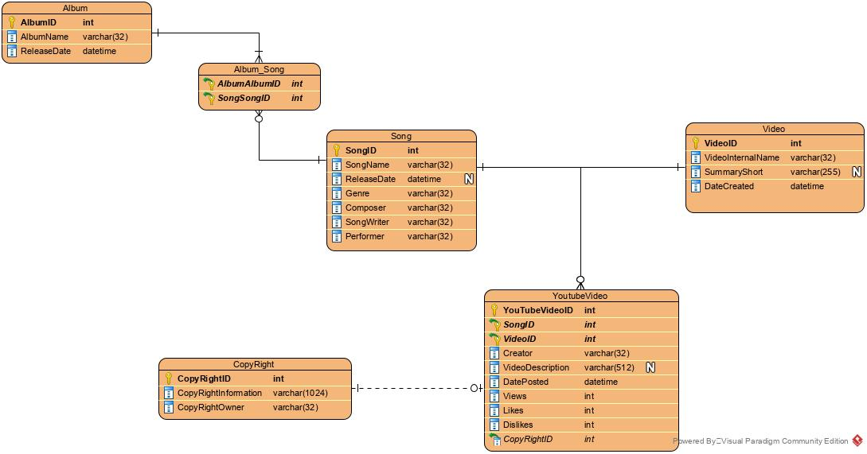
erd

Slide 22
DICTIONARY
DATA
NAME | DATA TYPE | SIZE | NULL/ NOT NULL | DESCRIPTION | EXAMPLE | KEY TYPE | DEFAULT
VideoID | INT | 10 | NOT NULL | Unique identifier assigned to each record in the Video table | 1 | PK | -
VideoTitle | VARCHAR | 32 | NULL | Title of the video posted | Oceans (Where Feet May Fail) - of Dirt and Grace - Hillsong UNITED | - | NULL
Views | INT | 10 | NOT NULL | Number of views a video has | 6,595,723 | - | -
DatePosted | DATETIME | - | NOT NULL | Date the video was posted | 2016-08-25T22:59:59.99 | - | -
CreatorID | INT | 10 | NOT NULL | Unique identifier assigned to each record in the Creator table | 1 | PK | -
Creator | VARCHAR | 32 | NOT NULL | Name of a content creator for YouTube | Hillsong UNITED | - | -
Singer | VARCHAR | 32 | NOT NULL | Name of the individual/s who performed in the song | Hillsong UNITED | - | -
Likes | INT | 10 | NOT NULL | Number of users that have upvoted the video | 83,000 | - | -
Licensee | VARCHAR | 32 | NULL | Name of the person/company the song is licensed to | John Doe | - | NULL
Licensor | VARCHAR | 32 | NULL | Name of the person/company that owns the license | Jane Doe | - | NULL
SongID | INT | 10 | NOT NULL | Unique identifier assigned to each record in the Song table | 1 | PK | -
SongTitle | VARCHAR | 32 | NOT NULL | Name of the song | Oceans (where feet may fail) | - | -

Slide 23

TARGET MAPPING
SOURCE | Data Source | https://www.youtube.com/watch?v=M9GcyHpptMk
 | Source Column | YoutubeVideoID | YoutubeVideoTitle | Creator | VideoDescription | DatePosted | Comments | Views | Likes | Dislikes
 | Source Datatype | INTEGER(10) | VARCHAR(32) | VARCHAR(32) | VARCHAR(512) | DATETIME | VARCHAR(255) | INTEGER(10) | INTEGER(10) | INTEGER(10)
 | Constraints (PK or FK) | PK | - | - | - | - | - | - | - | -
 | Format/Restrictions | NOT NULL | NOT NULL | NOT NULL | NULL | NOT NULL | NULL | NOT NULL | NOT NULL | NOT NULL
 | Notes | Unique Identifier | Title of the YouTube video | Channel that uploaded the video to YouTube | Num of reviews (as when scraped) | Date and time of when the video was posted to YouTube | Comments or notes or reviews made by users | Num of users that have intentionally watched video for more than 30 seconds | Number of likes for the video | Number of dislikes for the video
 | Default | - | - | - | NULL | - | NULL | - | - | -
TRANSFORMATION PROCESS | Business Key | Y
 | Transformation/ Business Rule | Where this attribute does not exist in the Target insert the new record | Update with source value if different between source and target | Update with source value if different between source and target | Update with source value if different between source and target | Update with source value if different between source and target | Update with source value if different between source and target | Update with source value if different between source and target | Update with source value if different between source and target | Update with source value if different between source and target
SOURCE TO

Slide 24
TARGET MAPPING
TARGET | Data Source | https://www.youtube.com/watch?v=M9GcyHpptMk
 | Source Column | YoutubeVideoID | YoutubeVideoTitle | Creator | VideoDescription | DatePosted | Comments | Views | Likes | Dislikes
 | Source Datatype | INTEGER(10) | VARCHAR(32) | VARCHAR(32) | VARCHAR(512) | DATETIME | VARCHAR(255) | INTEGER(10) | INTEGER(10) | INTEGER(10)
 | Constraints (PK or FK) | PK | - | - | - | - | - | - | - | -
 | Format/Restrictions | NOT NULL | NOT NULL | NOT NULL | NULL | NOT NULL | NULL | NOT NULL | NOT NULL | NOT NULL
 | Notes | Unique Identifier | Title of the YouTube video | Channel that uploaded the video to YouTube | Num of reviews (as when scraped) | Date and time of when the video was posted to YouTube | Comments or notes or reviews made by users | Num of users that have intentionally watched video for more than 30 seconds | Number of likes for the video | Number of dislikes for the video
 | Default | - | - | - | NULL | - | NULL | - | - | -
SOURCE TO

Slide 25
CONCLUSION
CONTENT RELEVANCE
EASY SEARCHES
ORGANIZED
IMPORTANCE OF VIDEO METADATA
IN
KEYWORDS
CONTEXT
STATISTICS

Slide 26





THANK
YOU
JAMIE LU
This Photo by Unknown Author is licensed under CC BY-SA
This Photo by Unknown Author is licensed under CC BY-SA
This Photo by Unknown Author is licensed under CC BY-SA
This Photo by Unknown Author is licensed under CC BY-ND

Slide 27
references
Bachmann, T. Video metadata modeling for DAM systems. J Digit Asset Manag 6, 247–256 (2010). https://doi.org/10.1057/dam.2010.34
Fairley, R. (n.d.). Encoding YouTube Videos at the Highest Quality. Retrieved December 08, 2020, from Videomaker: https://www.videomaker.com/article/c05/17034-encoding-youtube-videos-at-the-highest-quality#:~:text=Video%20Formats%20Accepted%20by%20YouTube,AVI%2C%20WMV%20and%20many%20others.
Google Support. (n.d.). Supported YouTube file formats. Retrieved December 08, 2020, from Youtube Help, Google Support: https://support.google.com/youtube/troubleshooter/2888402?hl=en
Guenther, R. (2009, June 11). Metadata standards at the Library of Congress. Retrieved December 07, 2020, from yumpu: https://www.yumpu.com/en/document/read/25061343/metadata-standards-at-the-library-of-congress
IBM. (2019). Video Metadata: Management Tools. Retrieved December 08, 2020, from IBM: https://www.ibm.com/downloads/cas/XVYMEYGM
Malik, H., & Tian, Z. (2017). A Framework for Collecting YouTube Meta-Data. Retrieved December 07, 2020, from Science Direct: https://pdf.sciencedirectassets.com/280203/1-s2.0-S1877050917X00124/1-s2.0-S187705091731757X/main.pdf?X-Amz-Security-
Token=IQoJb3JpZ2luX2VjEMb%2F%2F%2F%2F%2F%2F%2F%2F%2F%2FwEaCXVzLWVhc3QtMSJIMEYCIQCm8AeHvxc6phzqIEpLiM8xcFQaya%2BArrDSL99pMNSpQQIhAO8L9WdDAT
McKinney, K. (n.d.). How Hillsong Church conquered the music industry in God’s name. Retrieved December 08, 2020, from Fader: https://www.thefader.com/2018/10/11/hillsong-church-worship-songs-music-industry
Mediakix. (n.d.). What is a youtube creator? Retrieved December 08, 2020, from Mediakix: https://mediakix.com/blog/what-is-a-youtube-creator-definition/
Pastukhov, D. (2019, July 15). How Broken Metadata Affects the Music Industry (And What We Can Do About It)? Retrieved November 07, 2020, from Soundcharts Blog: https://soundcharts.com/blog/music-metadata
sokanu. (n.d.). What does a music artist do? Retrieved December 07, 2020, from CareerExplorer: https://www.careerexplorer.com/careers/music-artist/#:~:text=A%20music%20artist%20is%20someone,or%20through%20a%20record%20label.&text=Being%20a%20music%20artist%20requires,of%20talent%2C%20skill%20and%20knowledge.
TAXI. (n.d.). TAXI’s Music Industry & Production Glossary. Retrieved December 07, 2020, from TAXI: https://www.taxi.com/music-industry-glossary/
What exactly is rendering a movie or YouTube video? (2015). Retrieved December 08, 2020, from Reddit: https://www.reddit.com/r/explainlikeimfive/comments/35qcno/eli5what_exactly_is_rendering_a_movie_or_youtube/

